Slide 1

Robot Operating system
Define your robot
Lecturer: Dr. Bui Ha Duc
Dept. of Mechatronics
Email: ducbh@hcmute.edu.vn

Slide 2
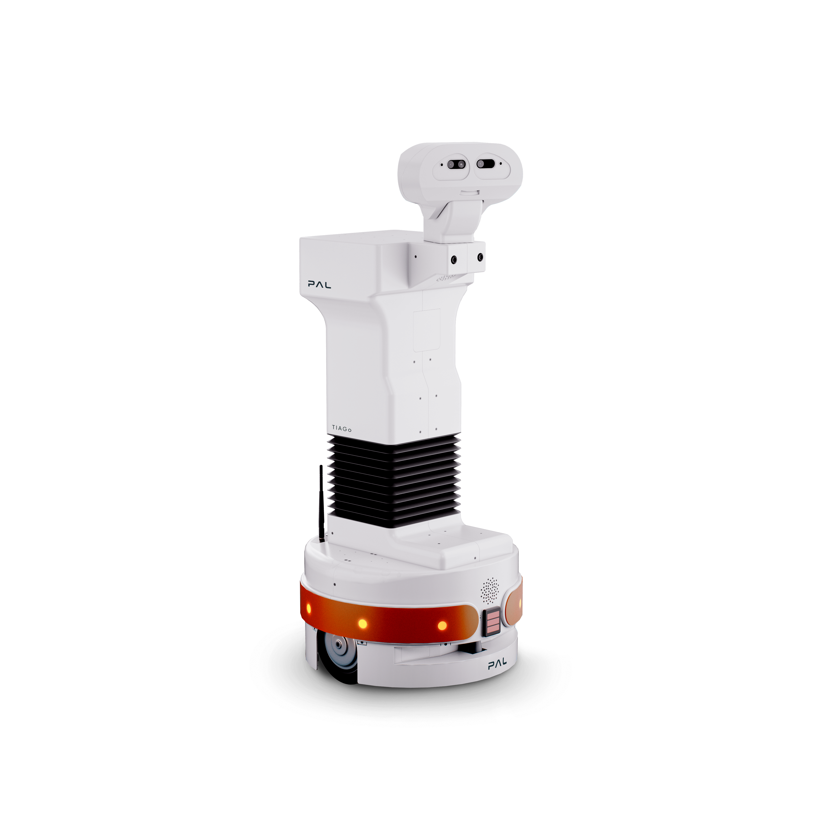
Define your robot
ROS
URDF
SDF
Gazebo

Slide 3
URDF - Unified Robot Description Format
Unified Robot Description Format (URDF) is an XML format used to describe all the elements of a robot.
  Links and joints
  Kinematic, dynamic and visual properties
Benefits of URDF:
  Simple and standardized
  Keep all the physical characteristic in one common place
URDF is made up of a few simple structures repeated over and over.

Slide 4
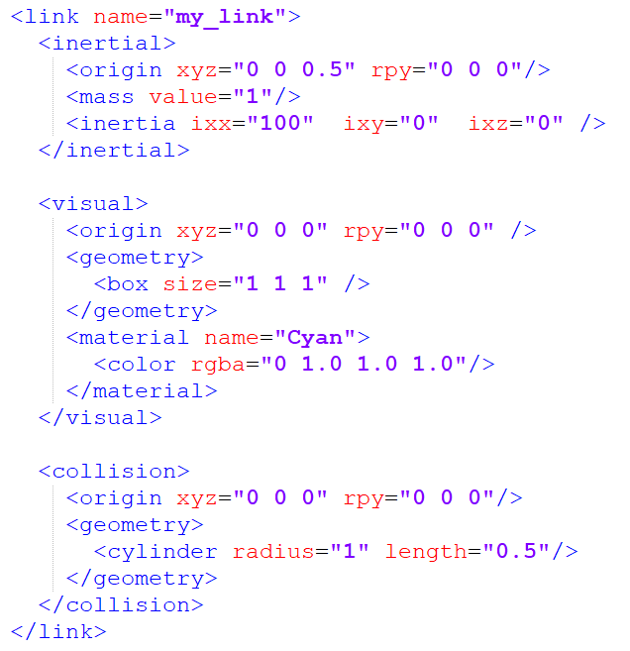
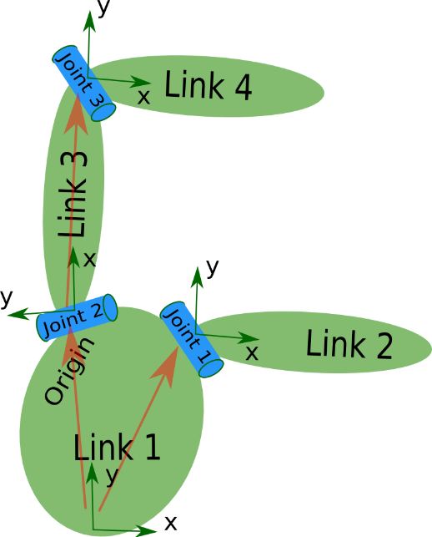
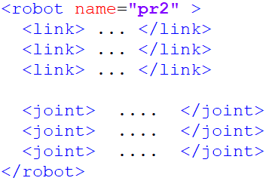
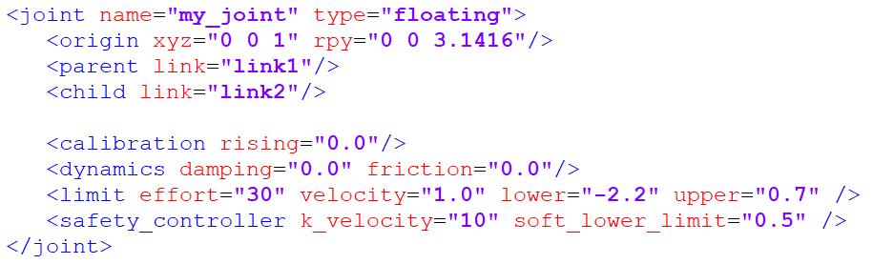
URDF Components
URDF consists of:
  Link elements: represent the physical components of the robot
  Joint elements: represent how one link moves relative to another link
pr2.urdf
More detail
http://wiki.ros.org/urdf/XML/model

Slide 5
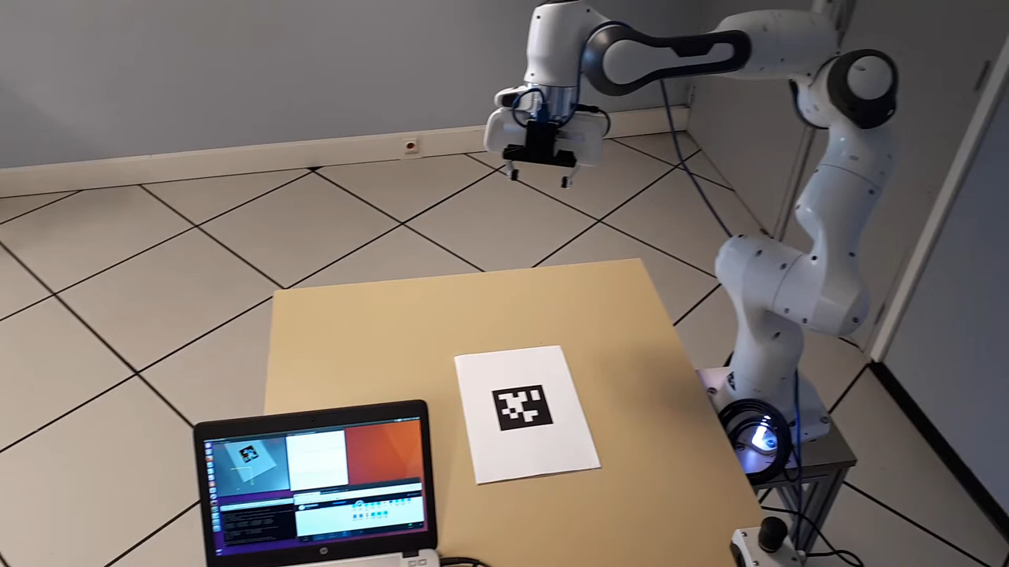
Links and Joints
Identify links and joints of this Robot arm

Slide 6
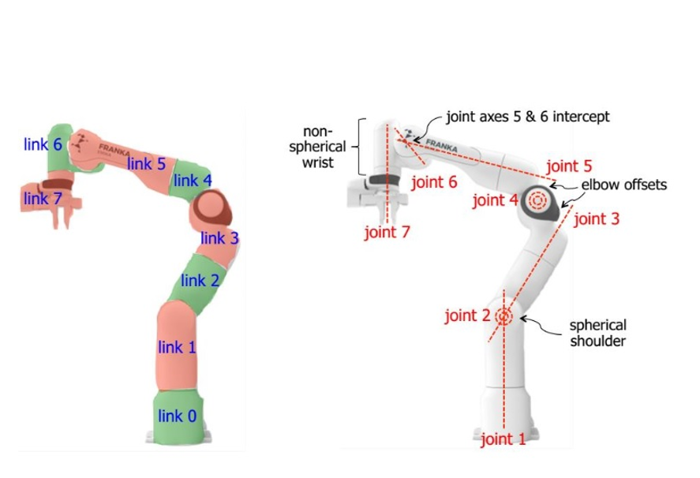
Links and Joints

Slide 7
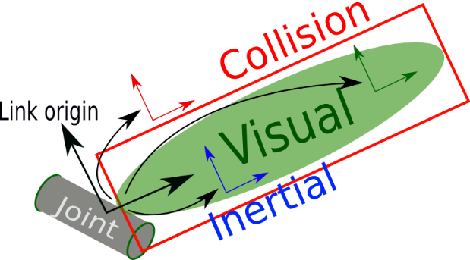
Links and Joints
Links
Visual - This is visual properties of the link.
  Geometry - box/ cylinder / sphere with size parameters, or a mesh
  Origin - an offset for the geometry so it doesn’t need to be centred around the link origin
  Material - Basically, the colour.
Inertial - used for physics calculations, but determines how the link responds to forces.
  Mass - Mass of the link
  Origin - The centre of mass (a.k.a centre of gravity).
  Inertia - The rotational inertia matrix.It describes how the distribution of the mass will affect rotation.
More detail
http://wiki.ros.org/urdf/XML/link

Slide 8
Links and Joints
Links
  Collision - used for physics collision calculations.
  Geometry and Origin - Same options as for visual. This will often be copy-pasted from the Visual tag.
More detail
http://wiki.ros.org/urdf/XML/link

Slide 9
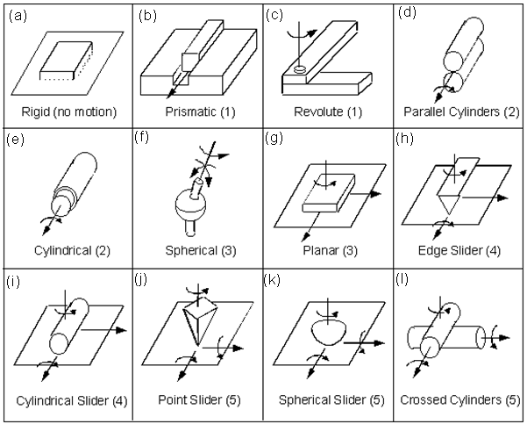
Links and Joints
Joints

Slide 10
Links and Joints
Joints: Each joint will need to have the following specified
  Name - A name for the joint.
  Type - joint type, the four most popular being fixed, prismatic, revolute, and continuous.
  Parent and child links - Which links this joint defines a relationship between
  Origin - The relationship between the two links, before any motion is applied
  Axis - Which axis to move along or around
  Limits - Physical actuation limits, which may be expected by other parts of the system. These can include:
  Upper and Lower position limits - in metres/radians
  Velocity limits - in m/s or rad/s
  Effort limits - in N or Nm

Slide 11
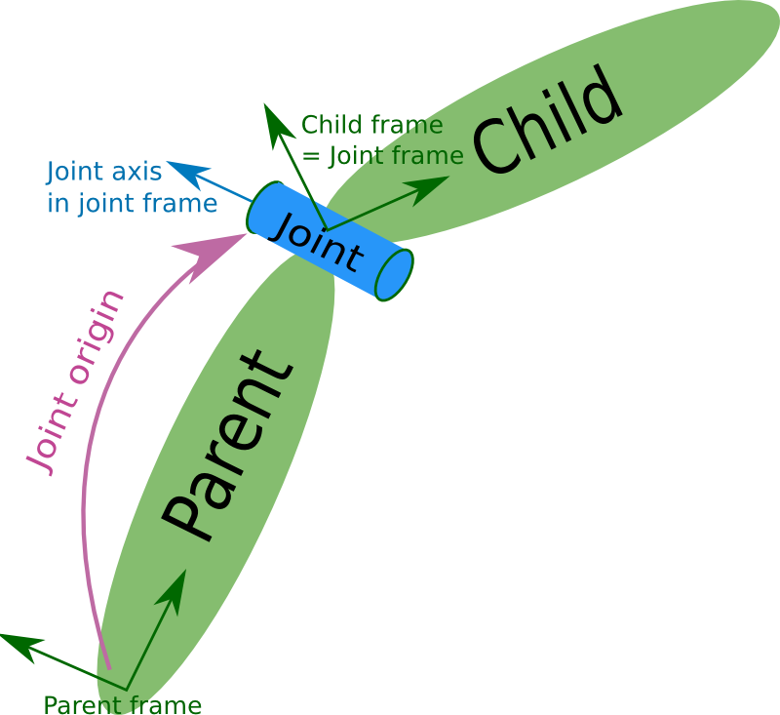
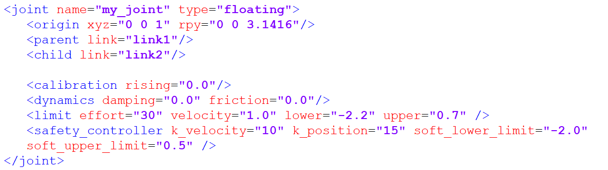
Links and Joints

Slide 12
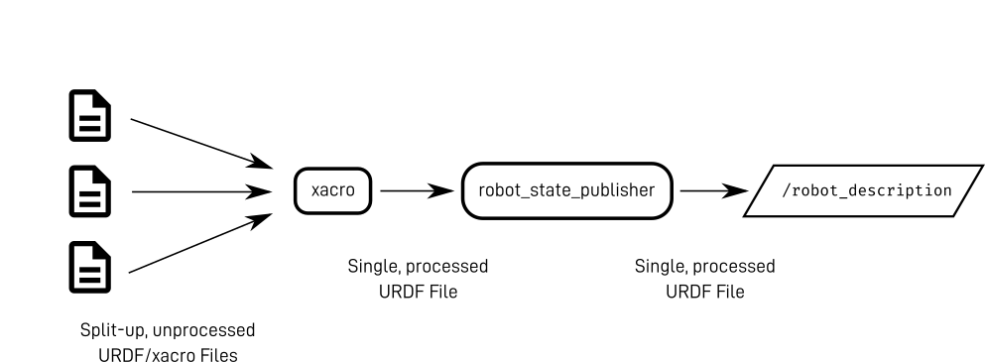
XML macro - xacro
URDF is generally long and repeatitive
Xacro lets us manipulate the URDF files easier by
  splitting up code into multiple files
  avoiding duplicate code
  Declaring properties
Notes:
https://www.youtube.com/watch?v=BcjHyhV0kIs&list=PLunhqkrRNRhYAffV8JDiFOatQXuU-NnxT&index=2

Slide 13
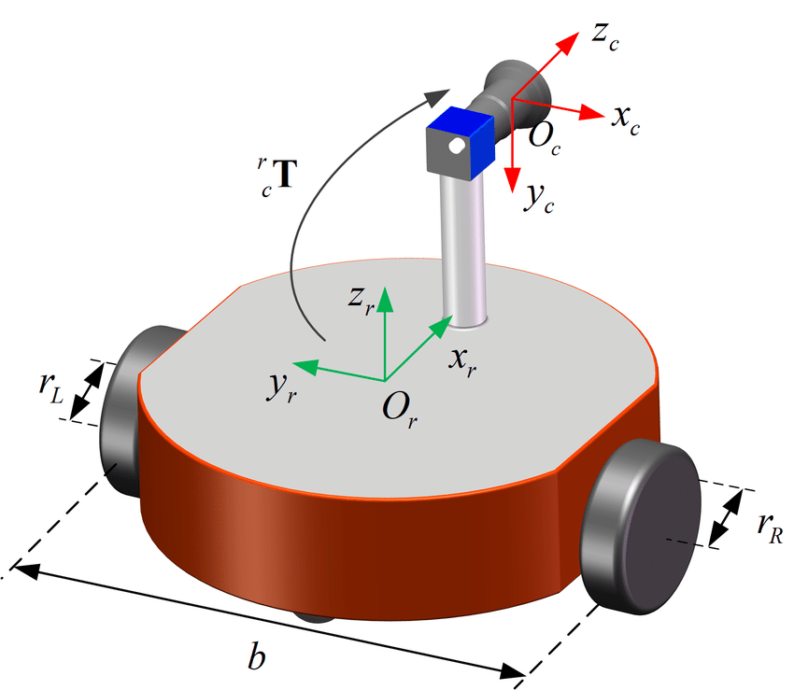
Exercise
Create URDF for a differential drive robot

Slide 14
Simulation the robot
in Gazebo

Slide 15
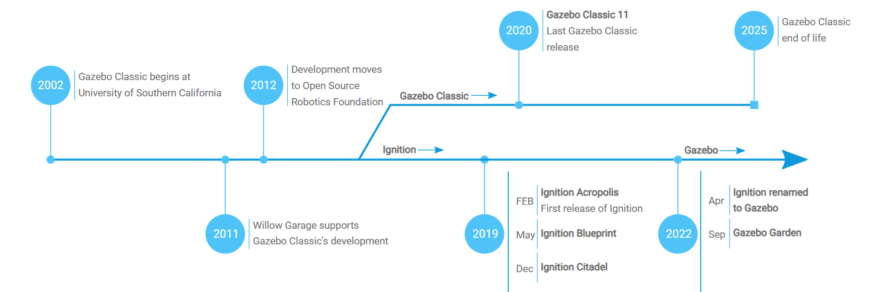
Gazebo
Gazebo is a leader in robot simulation, created in 2002
Official website: https://gazebosim.org/

Slide 16
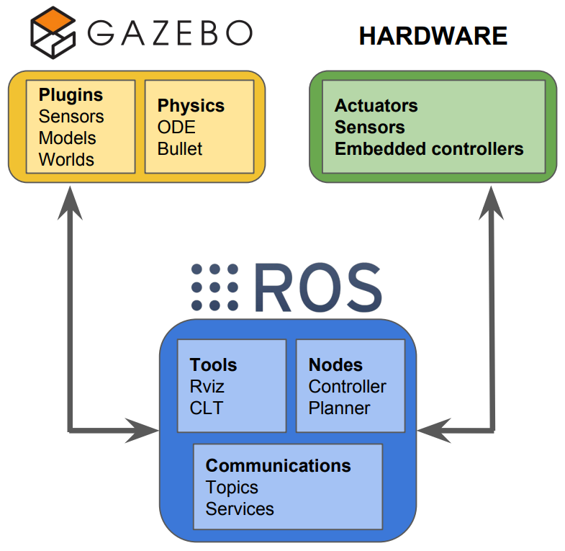
Gazebo
Gazebo is a 3D simulator with the ability to
  accurately and efficiently simulate robots, sensors, and objects in a 3-D dynamic environment
  Generates realistic sensor feedback and physical interactions between objects
Why simulation?
  Save time and your sanity
  Experimentation much less destructive
  Use hardware you don’t have
  Create really cool videos

Slide 17
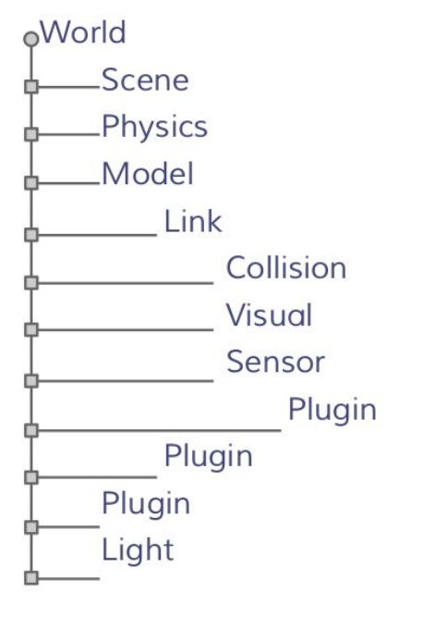
Elements in Gazebo
World
  A world is composed of a model hierarchy
  The Gazebo server reads the world file to generate and populate a world
  World file:
    Has “.world” extension
    Contains all the elements in a simulation, including scene, robots, lights, sensors, and static objects
  Build a world:
  https://classic.gazebosim.org/tutorials?tut=build_world

Slide 18
Elements in Gazebo
Model
  Model is a collection of links, joints,sensors, and plugins
  Model is defined using formatted using SDF (Simulation Description format) or URDF (Unified Robot Description Format)
  Each model contains a few key properties:
    Physical properties: visual, kinematics, dynamics, appearance
    Control and feedback interfaces (libgazebo)
  Create SDF from URDF
https://classic.gazebosim.org/tutorials?tut=ros_urdf

Slide 19
Elements in Gazebo
Plugin
  Gazebo plugins give your URDF models greater functionality
    Return sensor values
    Control motors
  Types of plugin:
    ModelPlugins
    SensorPlugins
    VisualPlugins
  More detail:
https://classic.gazebosim.org/tutorials?tut=ros_gzplugins

Slide 20
Elements in Gazebo
Sensor
  Collect, process, and output sensor data
  Types of sensor:
    Ray sensor: produces distance data
    Camera (2D and 3D): produces image and/or depth data
    Contact: produces collision data
    RFID: detects RFID tags
    IMU: produce Inertial Motion Unit data
  Example:
https://classic.gazebosim.org/tutorials?tut=ros_gzplugins

